Slide 1


Blockchain Based Criminal Information Management System in Sri Lanka
-- GROUP ID: 23-270 --

Slide 2

01
OVERALL PROJECT DESCRIPTION
TABLE OF CONTENT
02
IT20150952
SMART CONTRACT FOR BLOCKCHAIN
03
IT20171438
AUTHENTICATION SYSTEM
04
IT20157814
SECURE FILE MANAGEMENT SYSTEM
Project Details
Project ID: 23-270
Supervisor: Mr. Kanishka Yapa
Co-Supervisor: Ms. Dinithi Pandithage
05
IT19983370
BLOCKCHAIN CHAIN OF CUSTODY
06
REFERENCES

Slide 3





GROUP MEMBERS
IT20150952
BRAHANAWARDHAN B.
IT20171438
WIJAYARATHNE S.N.
IT20157814
AHMED M.N.H.
IT19983370
THUSHITHARAN M.

Slide 4

PROJECT OVERVIEW

Slide 5
Blockchain Based Criminal Information Management System
The project aims to develop a blockchain-based criminal information management system as an improvement of the existing criminal information management method in Sri Lankan. This system will leverage blockchain technology to enhance data Security, transparency and efficiency in managing criminal records
Designing Smart contract with blockchain network to ensure the CIA.
Multi-factor Authentication.
Developing Secure file management system for Blockchain Network.
Develop a Chain of custody process for Criminal System.

Slide 6
RESEARCH QUESTION
How can a blockchain-based criminal information management system be implemented effectively in Sri Lanka to enhance data security, transparency, and efficiency in the criminal justice system ?
Understand the Current Criminal System in Sri Lanka.
Identify the Stakeholders
Define the System Requirements
Develop a Blockchain Architecture
Integrate with Criminal System.

Slide 7
RESEARCH PROBLEM
Lack of integration
Inconsistent data quality
Privacy and security concern
Insufficient process
Lack of transparency

Slide 8
OBJECTIVES
01 SMART CONTRACT
03 Interplanetary file system
Deployment of Criminal Records in blockchain
To Secure Store criminal Evidence Document
02 Multi-Factor Authentication
04 Chain of custody
Prevent from the Unauthorized access
To provide a high level of security for criminal records verify the evidence

Slide 9
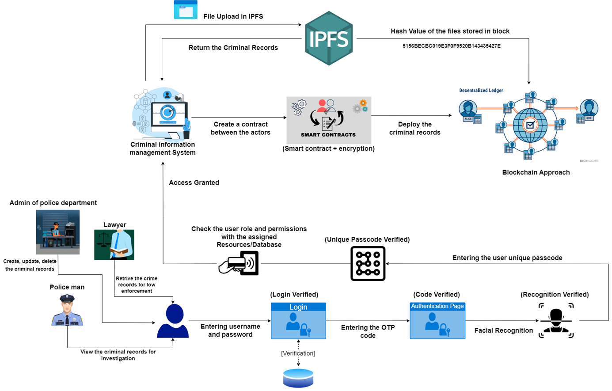
OVERALL SYSTEM DIAGRAM

Slide 10
IT20150952 | BRAHANAWARDHAN B.
Specializing in Cyber Security
DESIGN SMART CONTRACT FOR CRIMINAL SYSTEM
IT20150952 | BRAHANAWARDHAN B

Slide 11
RESEARCH QUESTION
RESEARCH PROBLEM
RESEARCH GAP
SUB OBJECTIVES
REQUIREMENTS
IT20150952 | BRAHANAWARDHAN B

Slide 12
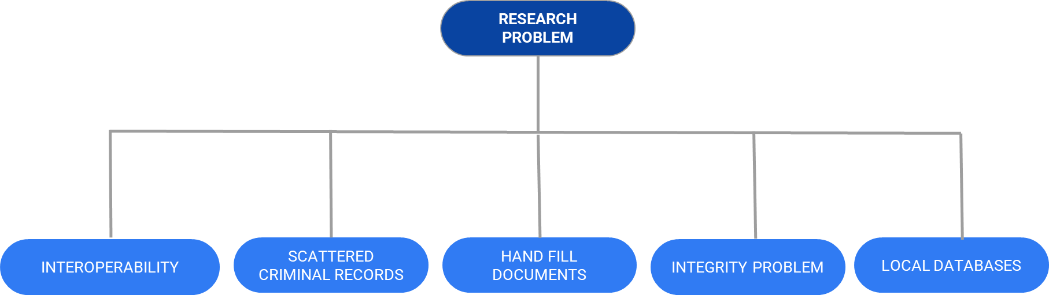
RESEARCH PROBLEM
IT20150952 | BRAHANAWARDHAN B

Slide 13
RESEARCH QUESTION
How can the implementation of smart contracts in a blockchain-based criminal information management system improve the efficiency, transparency, and security of criminal investigations in sri Lanka Criminal Information Management system ?
IT20150952 | BRAHANAWARDHAN B

Slide 14
RESEARCH GAP
CONSIDERATION ON | EXISTING LOCAL DATABASE BASED CRIMINAL INFORMATION MANAGEMENT SYSTEM IN SRI LANKA | BLOCKCHAIN TECHNOLOGY FOR CRIMINAL INFORMATION MANAGEMENT SYSTEM
Security of Sensitive Criminal Records | MEDIUM | HIGH
Decentralization Of System | LOW | HIGH
Ensure data Integrity | LOW | HIGH
Prevent loss of data | LOW | HIGH
Availability | MEDIUM | HIGH
Confidentiality | LOW | HIGH
IT20150952 | BRAHANAWARDHAN B

Slide 15

SPECIFIC OBJECTIVES
Increased efficiency, transparency, and security of Criminal Records.
Ensure Confidentiality, Integrity, Availability.
Reduce the lack of consistency.
Increase the performance and usability of criminal Records.
IT20150952 | BRAHANAWARDHAN B

Slide 16
SUB OBJECTIVES
Identify the current CIMS in Sri Lanka and limitation.
Review the literature on smart contracts.
Conduct a feasibility study
Identify the stakeholders
Develop a prototype
Recommendations and guidelines
IT20150952 | BRAHANAWARDHAN B

Slide 17
METHODOLOGY
Data Collections and understand the current criminal records handling method in Sri Lanka
Feasibility Study on Blockchain Network.
Design Smart contract for Blockchain.
Implementing Criminal System.
IT20150952 | BRAHANAWARDHAN B

Slide 18
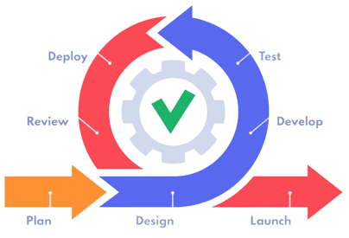
DEVELOPMENT CYCLE
Why ‘The Agile Life Cycle” was used?
Flexibility
Iterative Approach
Collaboration & Communication
Continuous Improvement
Rapid Prototyping
Time & Resource Management
IT20150952 | BRAHANAWARDHAN B

Slide 19
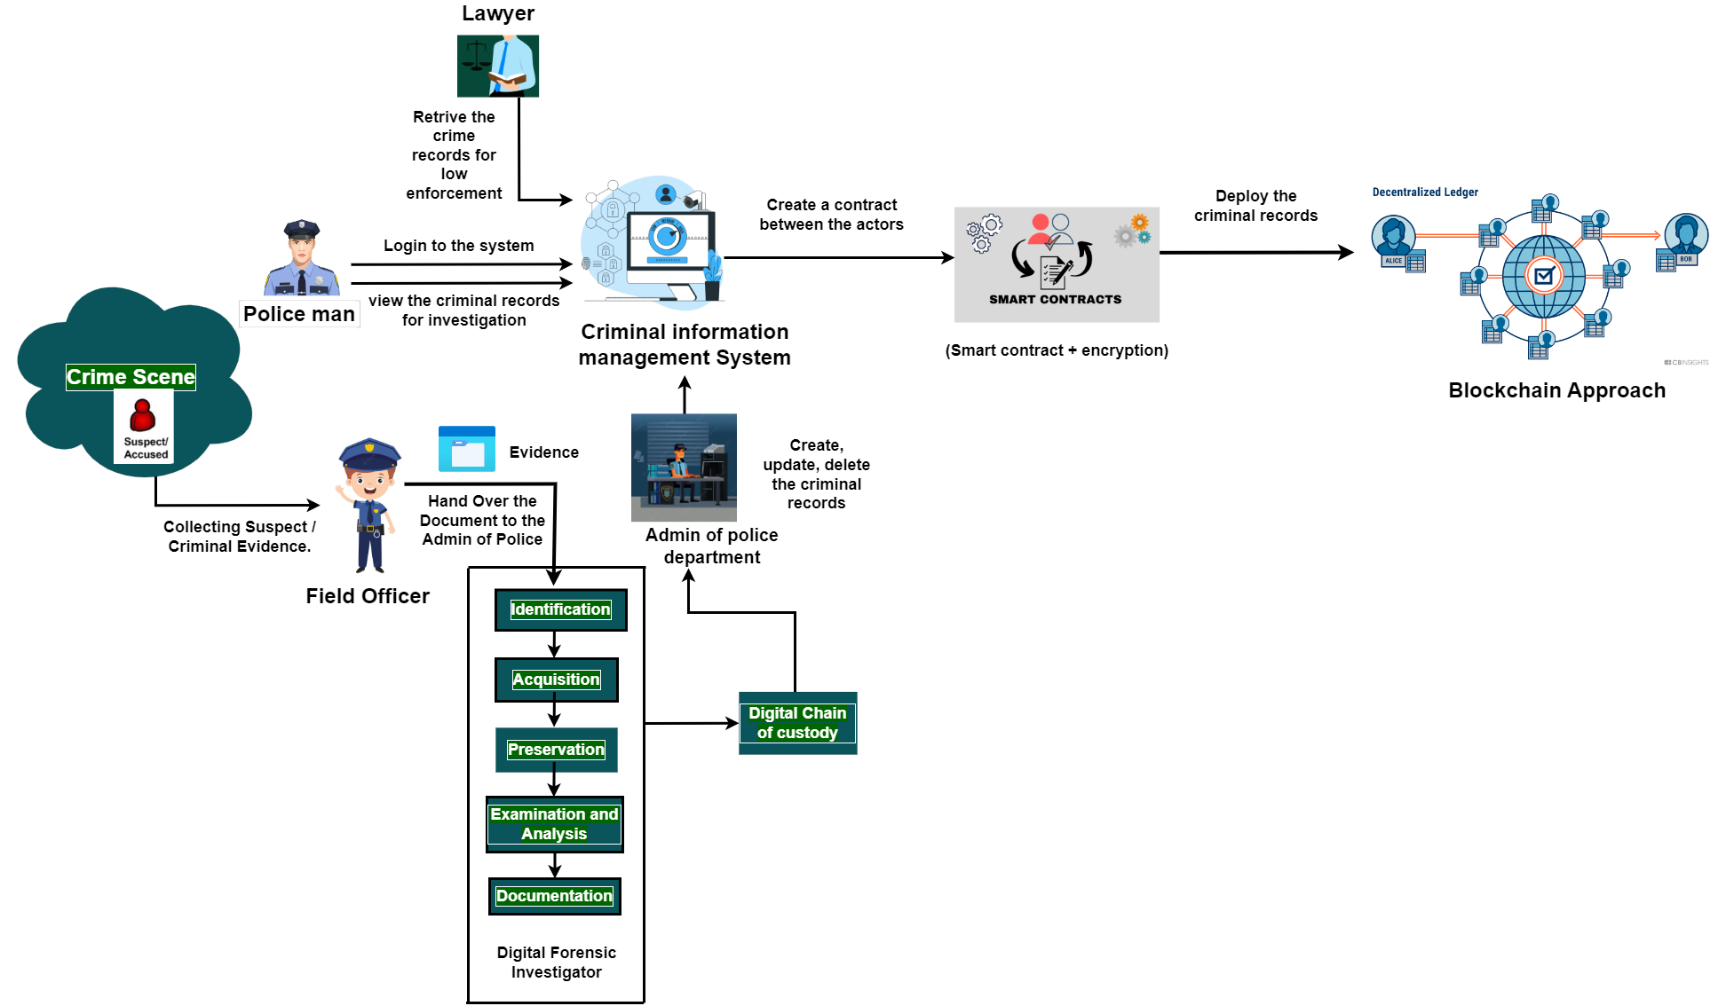
SYSTEM DIAGRAM
IT20150952 | BRAHANAWARDHAN B

Slide 20

FUNCTIONAL REQUIREMENTS
Criminal Records Data Entry
Criminal Records Data Search
Data Privacy and Security
Immutable Criminal Records Keeping
Integration with Criminal System.
IT20150952 | BRAHANAWARDHAN B

Slide 21
NON - FUNCTIONAL REQUIREMENTS
Scalability of the Blockchain
Reliability and Availability of Data.
Interoperability
Compliance
Usability
Performance
IT20150952 | BRAHANAWARDHAN B

Slide 22
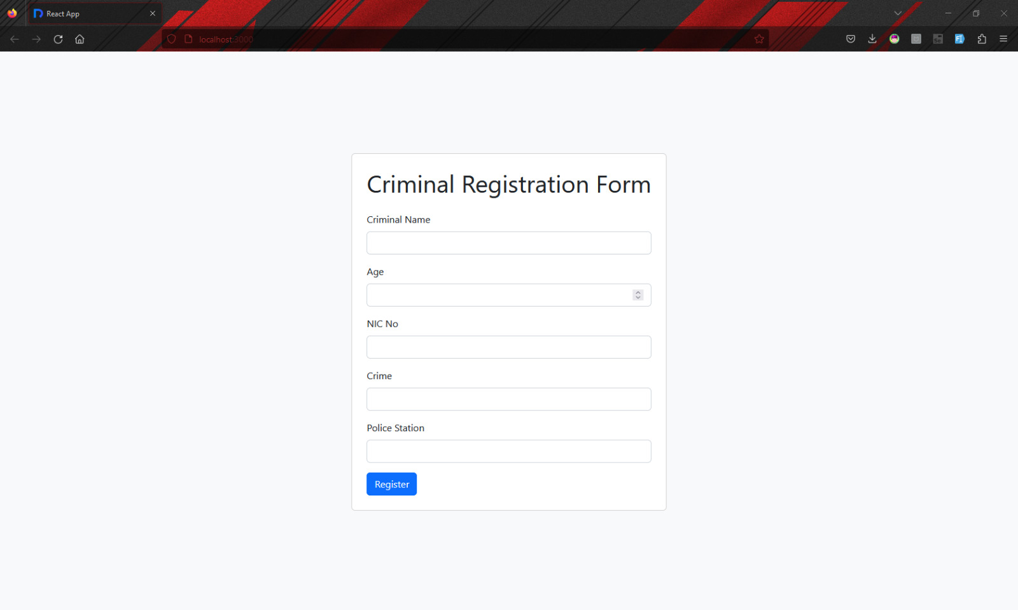
Criminal Data Entry web page
IT20150952 | BRAHANAWARDHAN B

Slide 23
IMPLEMENTATION
IT20150952 | BRAHANAWARDHAN B

Slide 24
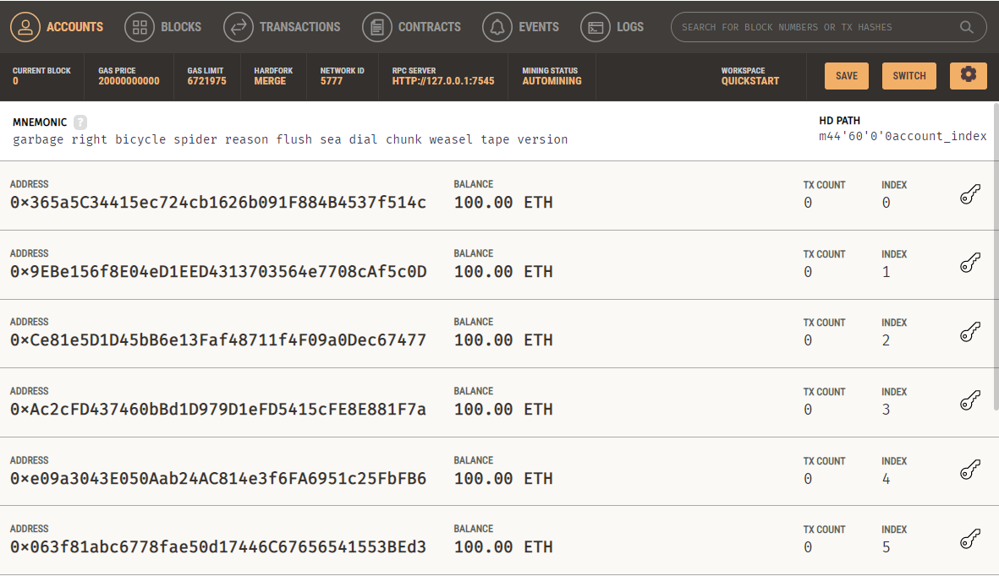
Ganache Blockchain for Criminal Information Management System
IT20150952 | BRAHANAWARDHAN B

Slide 25
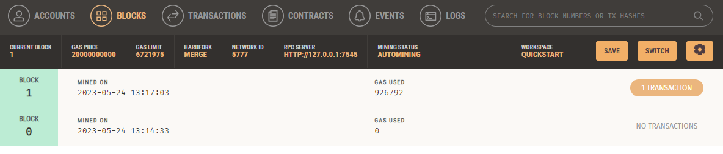
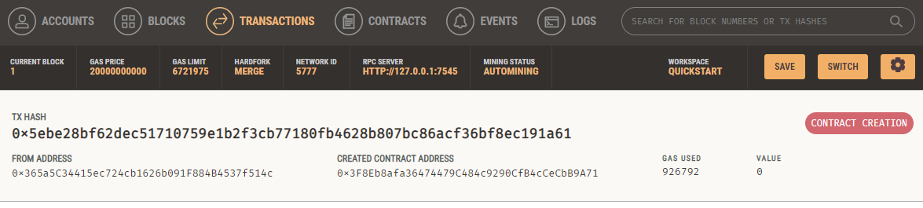
Ganache Blockchain for Criminal Information Management System
IT20150952 | BRAHANAWARDHAN B

Slide 26
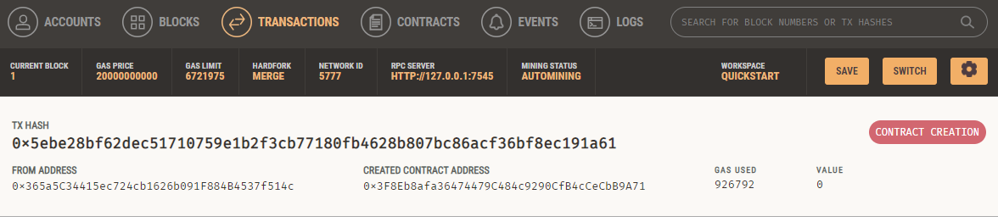
Ganache Blockchain for Criminal Information Management System
Initial Transaction
IT20150952 | BRAHANAWARDHAN B

Slide 27
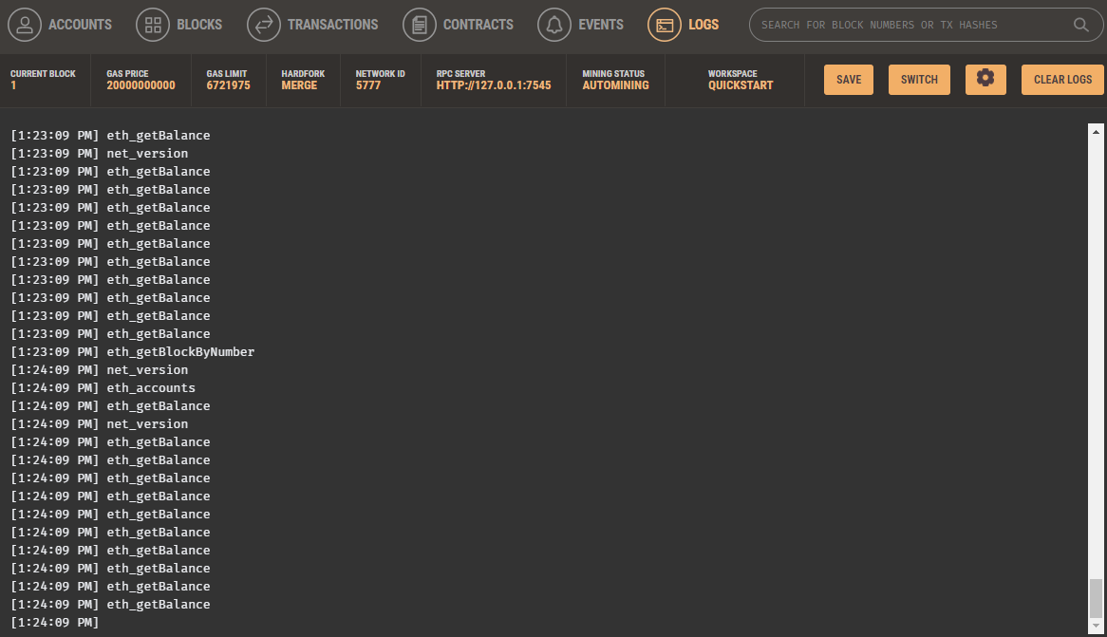
Ganache Blockchain for Criminal Information Management System
Record All logs from the transaction
IT20150952 | BRAHANAWARDHAN B

Slide 28
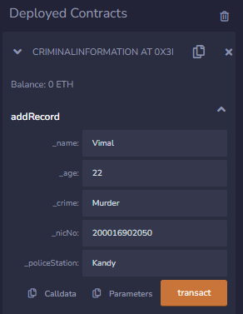
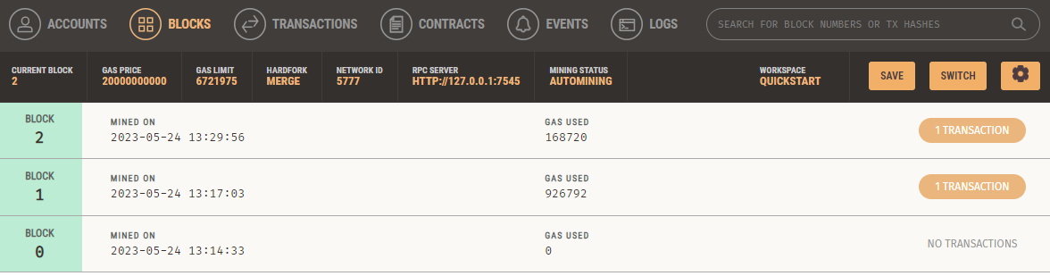
Working Functionality for Criminal Records - Input the Records
IT20150952 | BRAHANAWARDHAN B

Slide 29
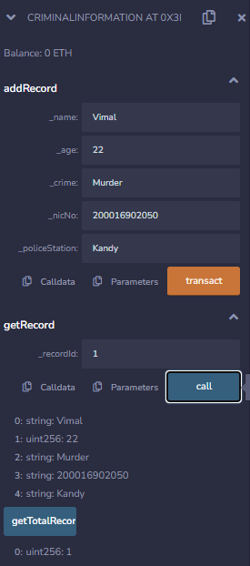
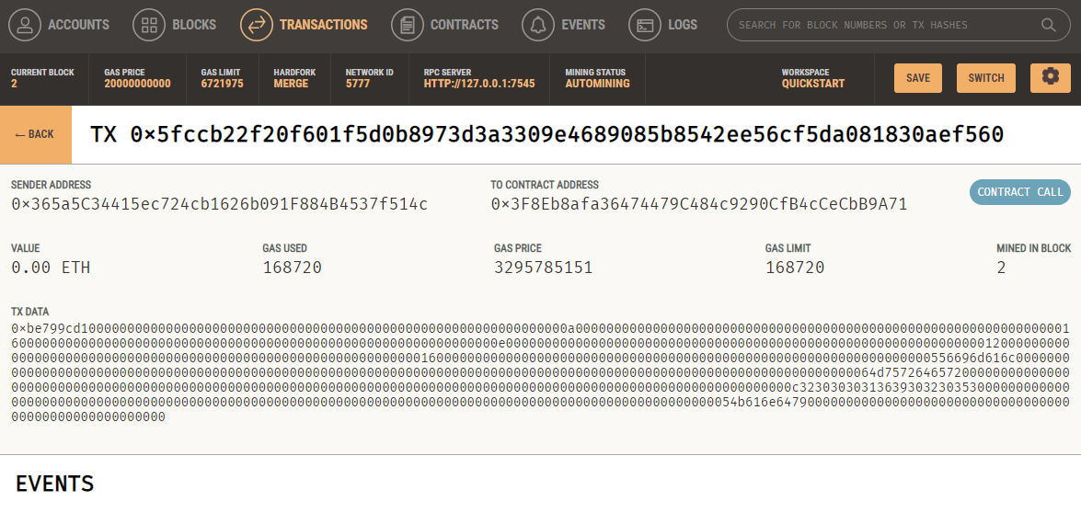

Slide 30
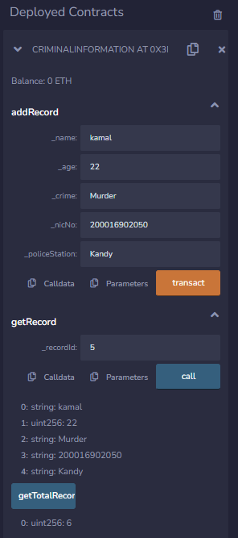
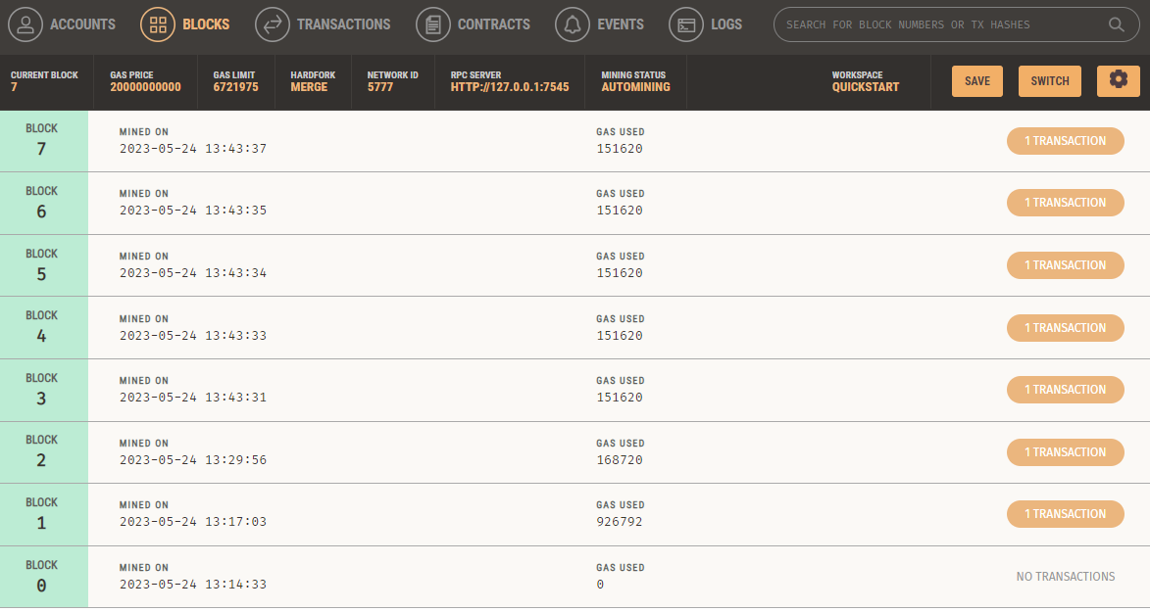

Slide 31
Demonstration
IT20150952 | BRAHANAWARDHAN B

Slide 32
PENDING WORK
Update Smart Contract and Integration
Integration with Criminal System.
IT20150952 | BRAHANAWARDHAN B

Slide 33
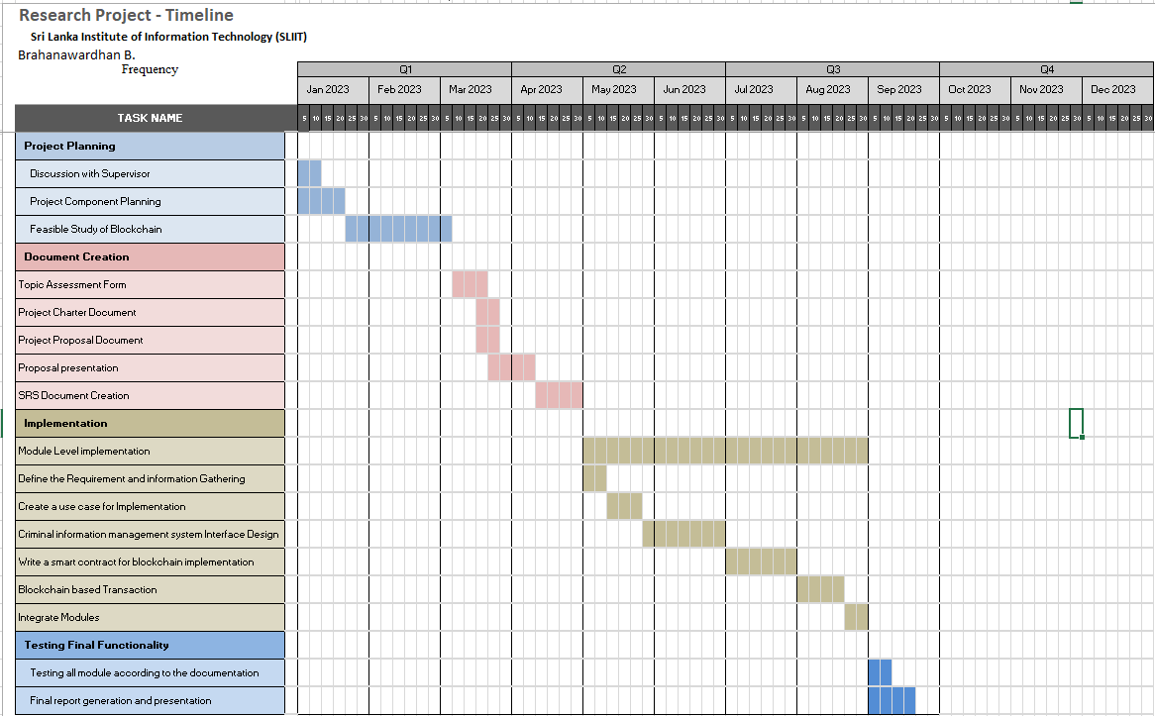

Slide 34
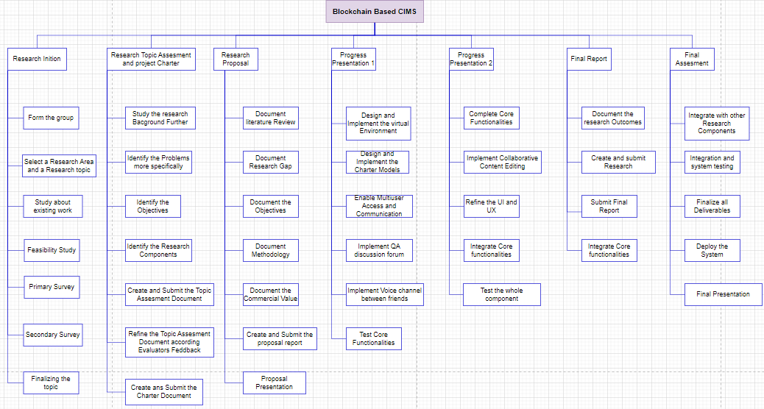

Slide 35
REFERENCES
“Blockchain-based Criminal Record Database Management.” [Online]. Available: https://ieeexplore.ieee.org/document/9544655. [Accessed: 19-Mar-2023].
“Crab: Blockchain based Criminal Record Management System.” [Online]. Available: https://www.researchgate.net/publication/329489346_CRAB_Blockchain_Based_ Criminal_Record_Management_System. [Accessed: 19-Mar-2023].
“Blockchain-based Criminal Record Database Management.” [Online]. Available: https://ieeexplore.ieee.org/document/9544655. [Accessed: 19-Mar-2023].
Wust, K., Gipp, B., & Breitenbücher, U. (2018). “Blockchain in forensic science: Securing digital evidence”. In 2018 41st International Convention on Information and Communication Technology, Electronics and Microelectronics (MIPRO) (pp. 1350- 1355). IEEE.
IT20150952 | BRAHANAWARDHAN B

Slide 36
IT20171438 | WIJAYARATHNE S. N.
Specializing in Cyber Security
MULTIFACTOR AUTHENTICATION SYSTEM

Slide 37
RESEARCH QUESTION
RESEARCH QUESTION
RESEARCH GAP
SUB OBJECTIVES
IT20171438 | WIJAYARATHNE S. N.

Slide 38





RESEARCH QUESTION
How To Secure System Login By Implementing A Secure Authentication System To The Blockchain- Based Criminal Information Management System In Sri Lanka?
Is 2-Factor Authentication SECURE? Can 2-Factor Authentication be HACKED?
SIM Swapping
SIM Cloning
Man-in-the-Middle Attacks
Phishing Attacks
Social Engineering
IT20171438 | WIJAYARATHNE S. N.

Slide 39
RESEARCH GAP
CONSIDERATION ON | EXISTING SYSTEMS | PROPOSED SYSTEM
1ST FACTOR | Security Level is LOW | Security Level is HIGH
2ND FACTOR | Security Level is MODERATE | Security Level is HIGH
3RD FACTOR | Security Level is MODERATE | Security Level is HIGH
CONFIDENTIALITY | Security Level is LOW | Security Level is HIGH
INTEGRITY | Security Level is LOW | Security Level is HIGH
POSSIBLE OTP COMBINATIONS | LOW (59,049) | HIGH (60,466,176)
ARTIFICIAL INTELLIGENCE | NONE | IMPLEMENTED
OVERALL SYSTEM | Security Level is MODERATE | Security Level is HIGH
IT20171438 | WIJAYARATHNE S. N.

Slide 40
SPECIFIC & SUB OBJECTIVES
Proposed Authentication System;
Three-Factor Authentication (3FA) System
Additional Layer of Security Implemented at the End.
The 1st Factor;
Username and Password
The 2nd Factor;
One-Time Password
The 3rd Factor;
Facial Recognition
Additional Layer of Security;
System Generated Unique Passcode
IT20171438 | WIJAYARATHNE S. N.

Slide 41
METHODOLOGY
DEVELOPMENT CYCLE
SYSTEM DIAGRAM
SYSTEM DESCRIPTION
REQUIREMENTS
IT20171438 | WIJAYARATHNE S. N.

Slide 42
DEVELOPMENT CYCLE
Why ‘The Agile Life Cycle” was used?
Flexibility
Iterative Approach
Collaboration & Communication
Continuous Improvement
Rapid Prototyping
Time & Resource Management
IT20171438 | WIJAYARATHNE S. N.

Slide 43
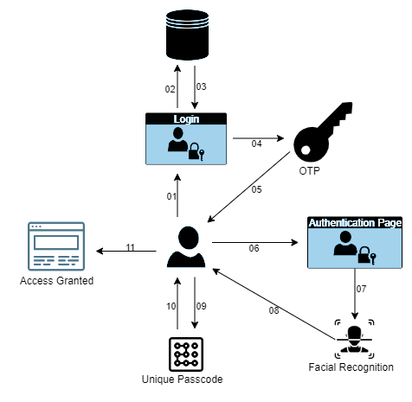
SYSTEM DIAGRAM
01 – User entering Username & Password
02 – Entered Username & Password being checked
03 – Username & Password being verified
04 – Moving to the OTP page
05 – OTP code will be send to the client
06 – Entering the OTP code to the Authentication Page
07 – Moving to the Facial Recognition Page
08 – Facial Recognition Process
09 – User entering the Unique Passcode
10 – Verifying the Unique Passcode
11 – Access Granted to the System
IT20171438 | WIJAYARATHNE S. N.

Slide 44
SYSTEM DESCRIPTION
1st Factor;
Highest-level of Security Standards
Alerts Generated
Number of Attempts
2nd Factor;
6-Digit Code → 6-Character Code [59,049 → 60,466,176]
Number of Attempts
Time Restriction
3rd Factor;
AI Trained Algorithm
Number of Attempts
Additional Layer of Security;
Unique System Generated Code
Code Expiration
IT20171438 | WIJAYARATHNE S. N.

Slide 45
REQUIREMENTS
Functional Requirements
Non-Functional Requirements
User Registration
Factor Options
Factor Management
Authentication Workflow
Integration with Applications
Authentication Logging
Security
Performance
Reliability
Usability
Scalability
Compliance
IT20171438 | WIJAYARATHNE S. N.

Slide 46
IMPLEMENTATION
LAYOUTS
CODES
DATABASE
DATASET
IT20171438 | WIJAYARATHNE S. N.

Slide 47

LAYOUTS
IT20171438 | WIJAYARATHNE S. N.

Slide 48
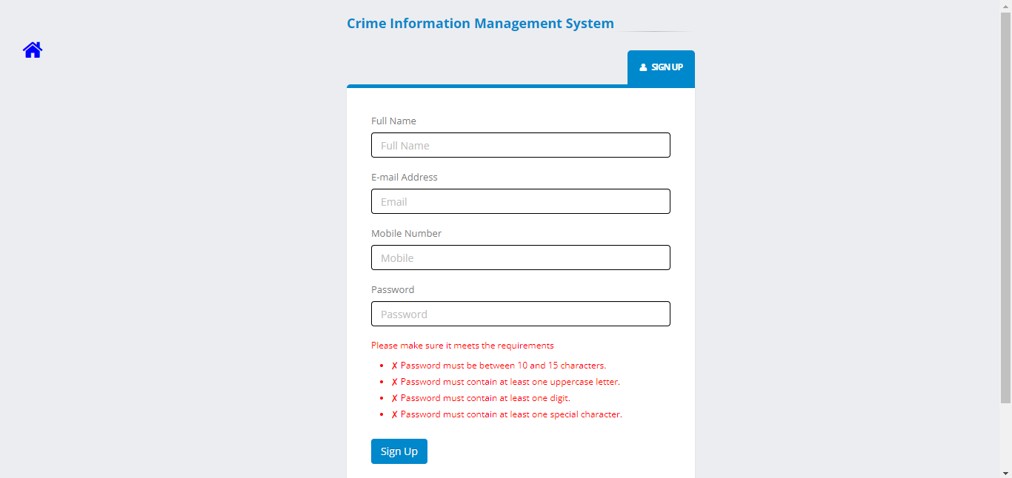
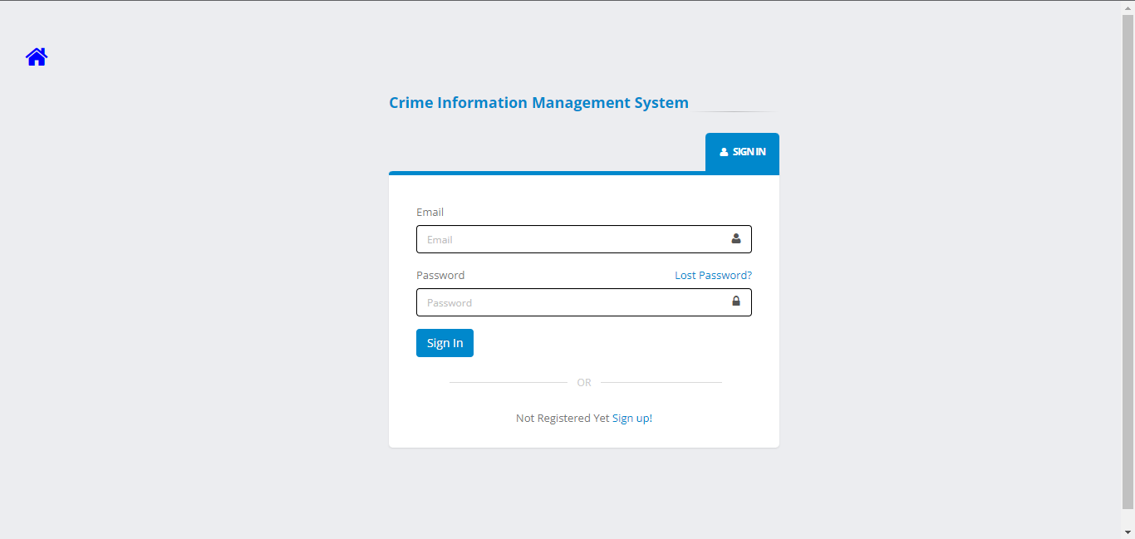
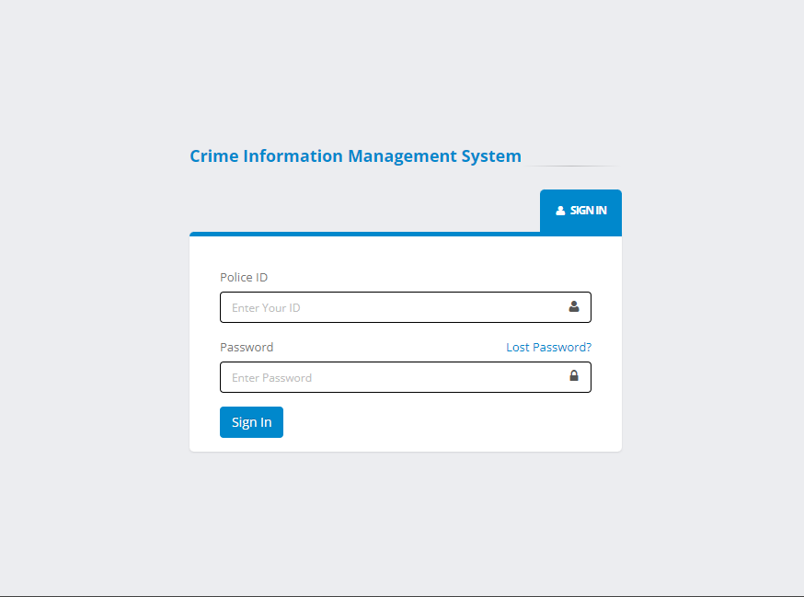
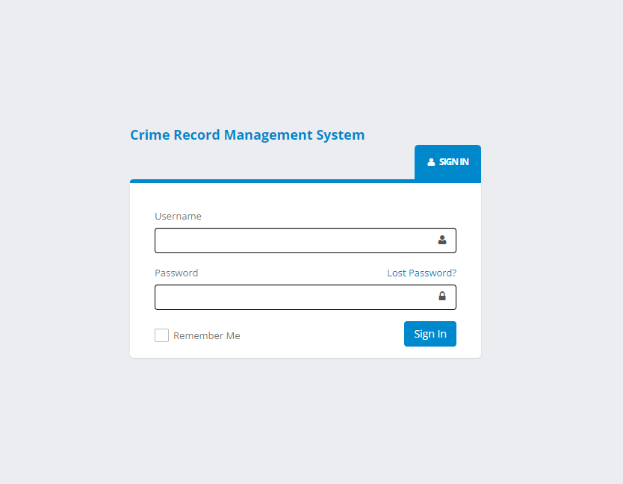
LAYOUTS
User
User
Police
Admin
IT20171438 | WIJAYARATHNE S. N.

Slide 49
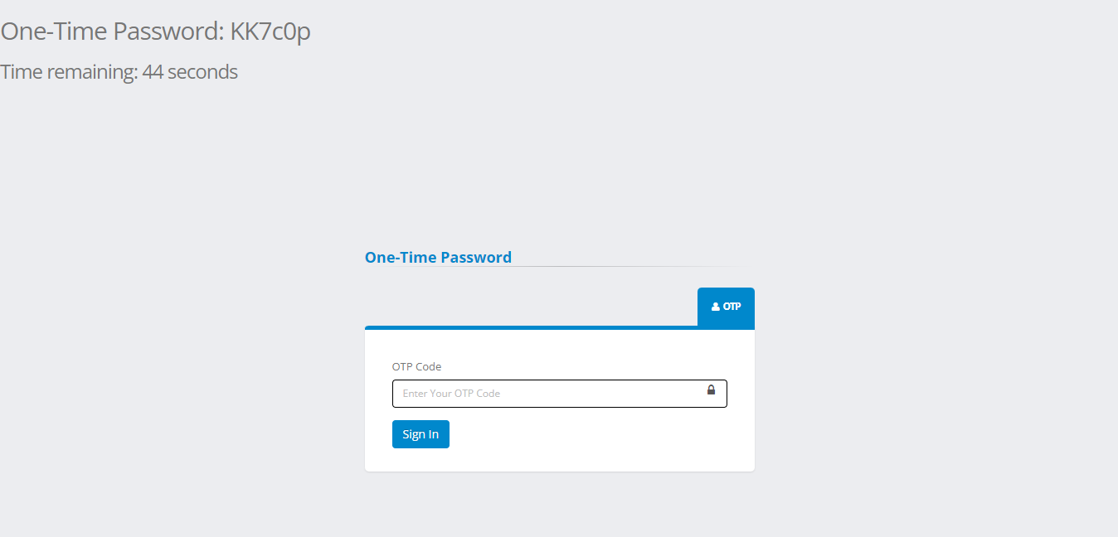
LAYOUTS
IT20171438 | WIJAYARATHNE S. N.

Slide 50
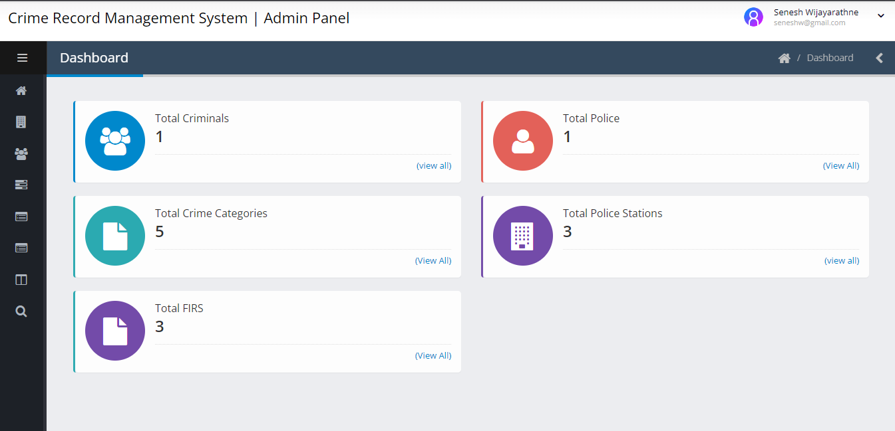
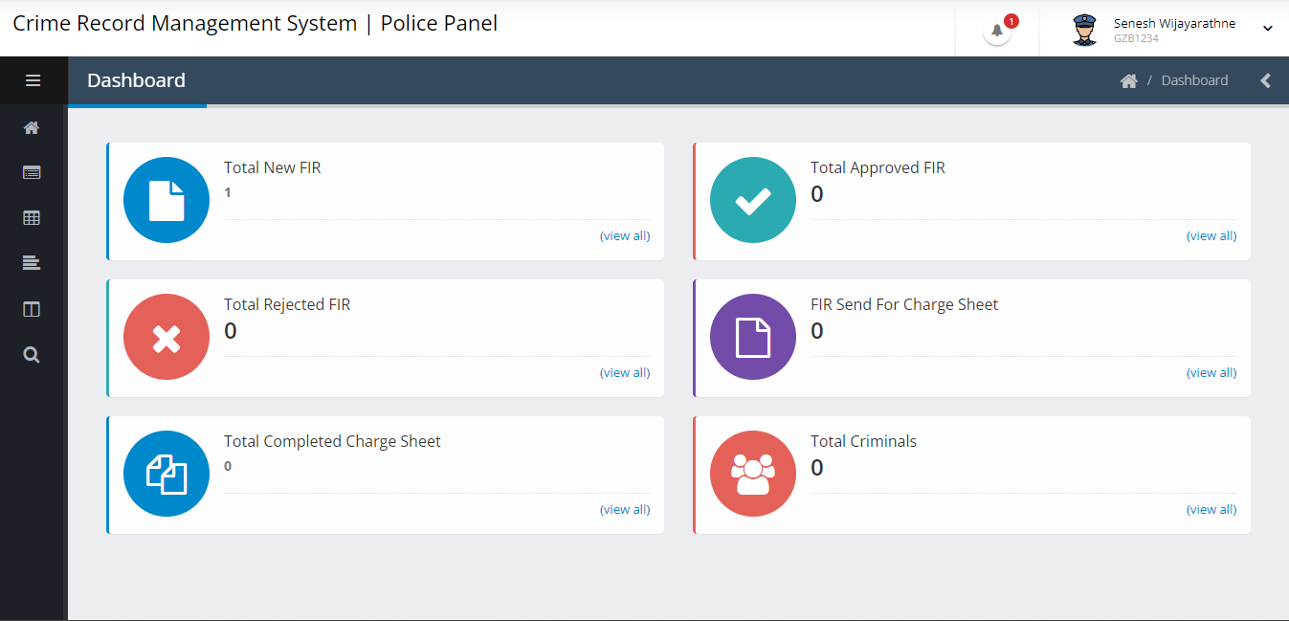
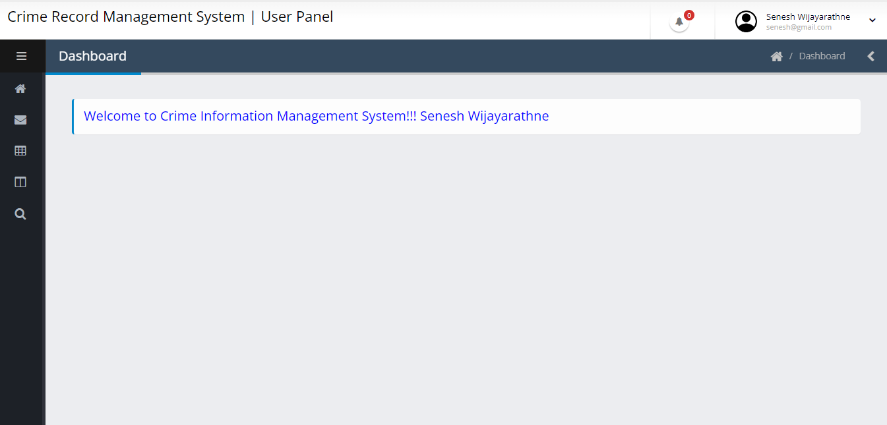
LAYOUTS
IT20171438 | WIJAYARATHNE S. N.

Slide 51
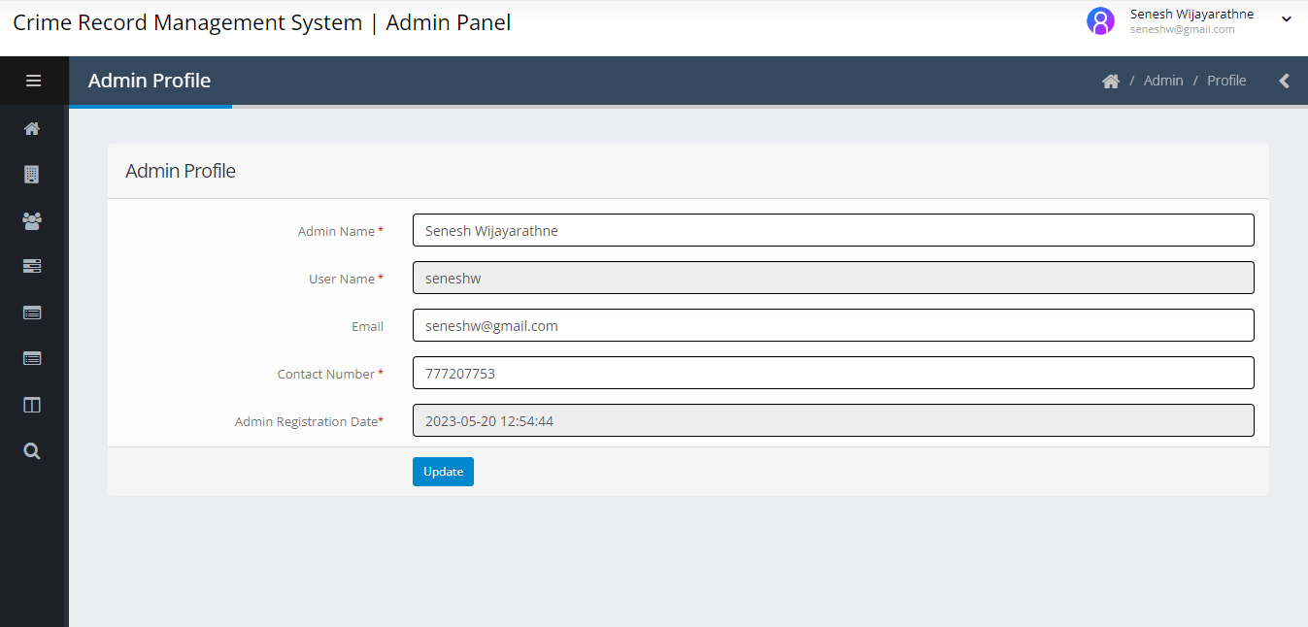
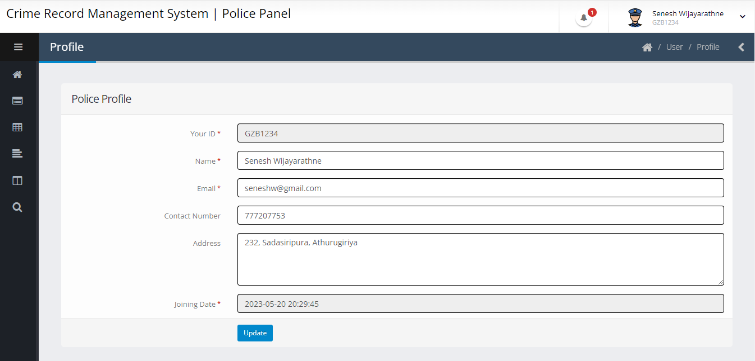
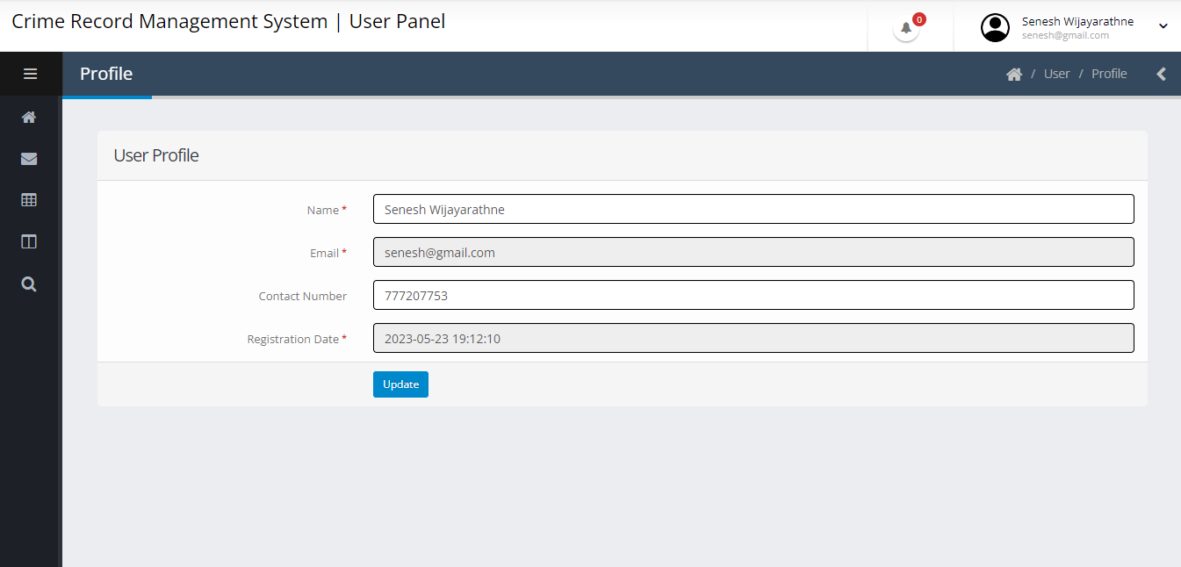
LAYOUTS
IT20171438 | WIJAYARATHNE S. N.

Slide 52
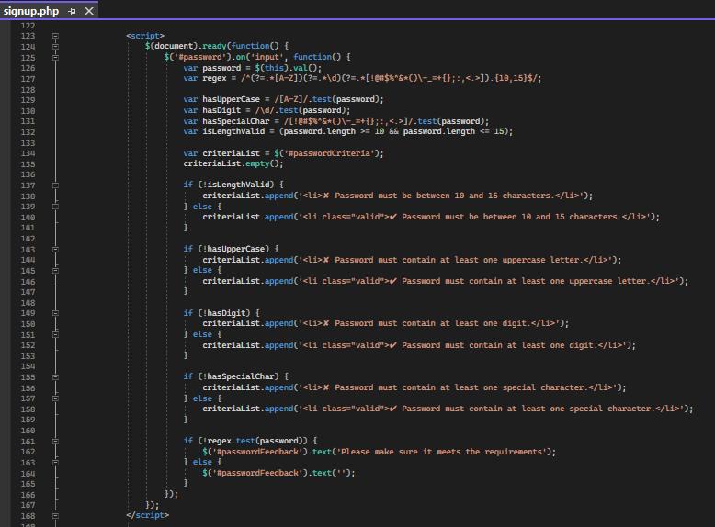
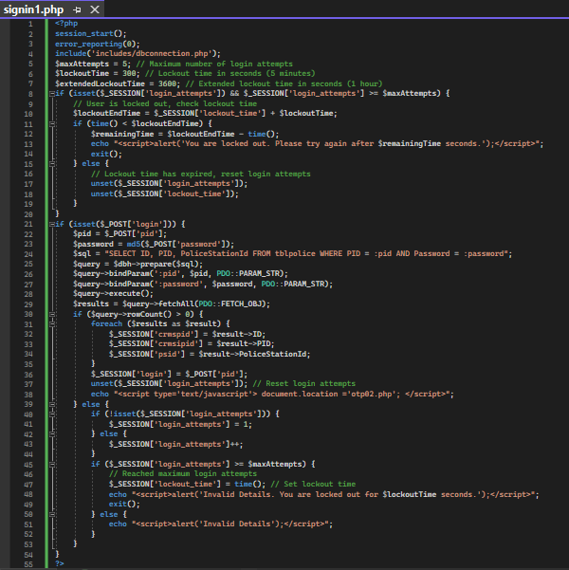
CODE
IT20171438 | WIJAYARATHNE S. N.

Slide 53
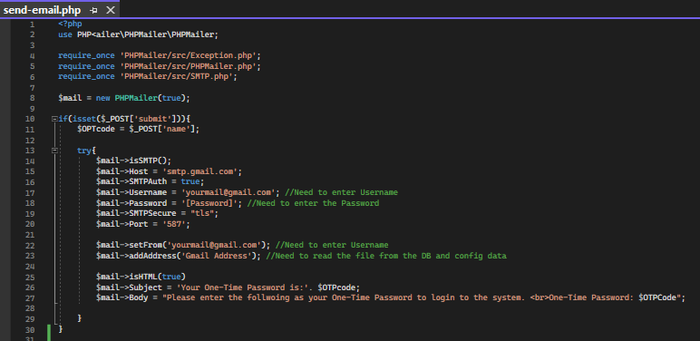
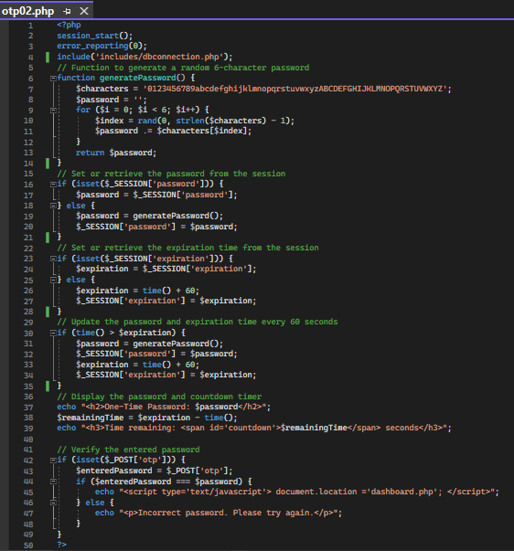
CODE
IT20171438 | WIJAYARATHNE S. N.

Slide 54
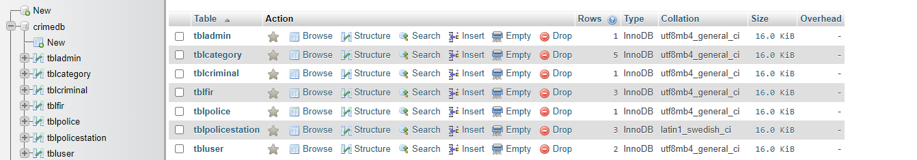
DATABASE
IT20171438 | WIJAYARATHNE S. N.

Slide 55
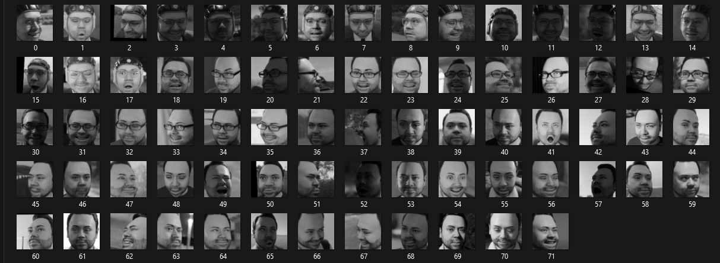
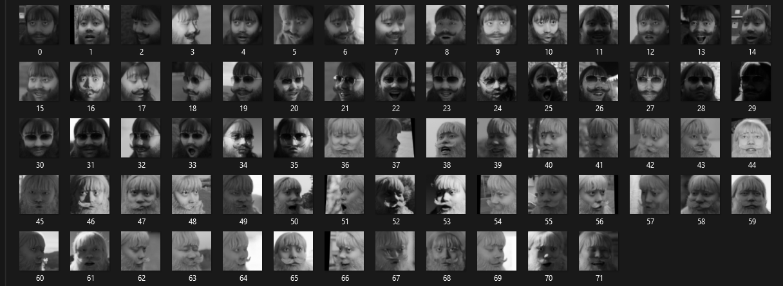
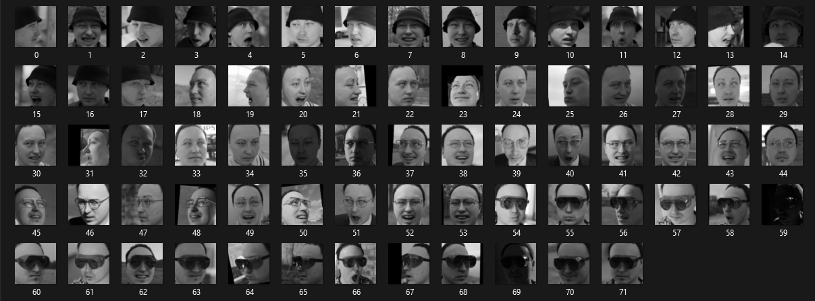
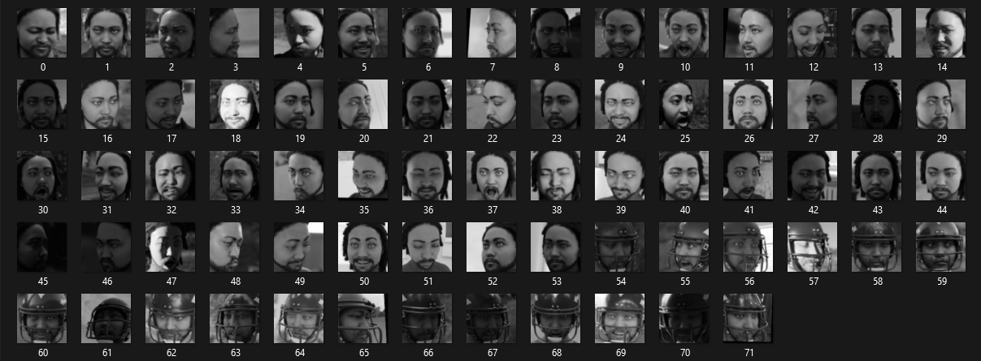
DATASET
IT20171438 | WIJAYARATHNE S. N.

Slide 56
DEMONSTRATION
USER SIGN UP & SIGN IN
ADMIN & POLICE OFFICER SIGN IN
ACCOUNT LOCK
6-CHARACTER CODE & VALIDATION
ALL USER PROFILES
DASHBOARDS
IT20171438 | WIJAYARATHNE S. N.

Slide 57
PENDING WORK
SETUP SMTP & SMS GATEWAY PROVIDER
IMPLEMENT FACIAL RECOGNITION
INTEGRATE WITH OTHER SYSTEM
IT20171438 | WIJAYARATHNE S. N.

Slide 58
OTHER INFORMATION
GANTT CHART
SCHEDULE
REFERENCES
IT20171438 | WIJAYARATHNE S. N.

Slide 59
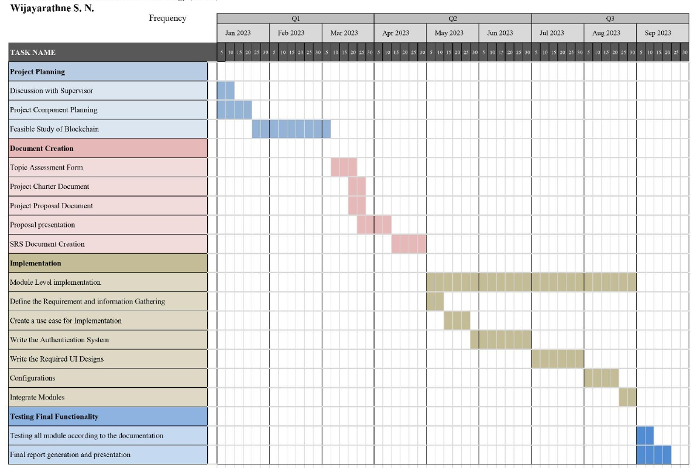
GANTT CHART
IT20171438 | WIJAYARATHNE S. N.

Slide 60
SCHEDULE
M
T
W
T
F
S
S
Week 1
-
-
-
1
2
3
4
SETUP SMTP & SMS GATEWAY PROVIDER
Week 2
5
6
7
8
9
10
11
FINAL EXAMS
Week 3
12
13
14
15
16
17
18
2FA COMPLETION
FACIAL RECOGNITION SETUP CONFIGURATION
Week 4
19
20
21
22
23
24
25
IMPLEMENTING FACIAL RECOGNITION SCANNER #01
Week 5
26
27
28
29
30
-
-
DATASET
TESTING & BUG FIX
IT20171438 | WIJAYARATHNE S. N.

Slide 61
REFERENCES
R. P. Jover, "Security analysis of SMS as a second factor of authentication," Commun. ACM, vol. 63, no. 12, p. 46–52, 17 November 2020, doi: doi.org/10.1145/3424260
V. Papaspirou, L. Maglaras, M. A. Ferrag, I. Kantzavelou, H. Janicke and C. Douligeris, "A novel Two-Factor HoneyToken Authentication Mechanism," 2021 International Conference on Computer Communications and Networks (ICCCN), Athens, Greece, 2021, pp. 1-7, doi: 10.1109/ICCCN52240.2021.9522319.
Konoth, R.K., van der Veen, V., Bos, H. (2017). How Anywhere Computing Just Killed Your Phone-Based Two-Factor Authentication. In: Grossklags, J., Preneel, B. (eds) Financial Cryptography and Data Security. FC 2016. Lecture Notes in Computer Science, vol 9603. Springer, Berlin, Heidelberg. https://doi.org/10.1007/978-3-662-54970-4_24
Adham, M., Azodi, A., Desmedt, Y., Karaolis, I. (2013). How to Attack Two-Factor Authentication Internet Banking. In: Sadeghi, AR. (eds) Financial Cryptography and Data Security. FC 2013. Lecture Notes in Computer Science, vol 7859. Springer, Berlin, Heidelberg. https://doi.org/10.1007/978-3-642-39884-1_27
IT20171438 | WIJAYARATHNE S. N.

Slide 62
IT20157814 | M.N H AHMED
Specializing in Cyber Security
SECURE FILE MANAGEMENT SYSTEM

Slide 63
RESEARCH QUESTION
RESEARCH QUESTION
RESEARCH GAP
SUB OBJECTIVES
IT20157814 | M.N H AHMED

Slide 64
RESEARCH QUESTION
How can Implementing secure file management system to ensure confidentiality, integrity, and availability of the files, in blockchain based criminal information management system for Sri Lanka?
IT20157814 | M.N H AHMED

Slide 65
RESEARCH GAP
 | Existing System (Manual/Centralized System) | Secure File Management System in Decentralized Network
Confidentiality | Low | High
Integrity | Low | High
Availability | Low | High
IT20157814 | M.N H AHMED

Slide 66
SPECIFIC & SUB OBJECTIVES
Implementing cryptography secure file management system to share file
Implementing cryptography secure file management system to store file.
Ensure Confidentiality, Integrity, Availability.
Increase the performance and usability of criminal Records.
IT20157814 | M.N H AHMED

Slide 67
METHODOLOGY
DEVELOPMENT CYCLE
SYSTEM DIAGRAM
SYSTEM DESCRIPTION
REQUIREMENTS
IT20157814 | M.N H AHMED

Slide 68
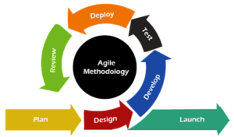
DEVELOPMENT CYCLE
‘The Agile Life Cycle” was used
IT20157814 | M.N H AHMED

Slide 69
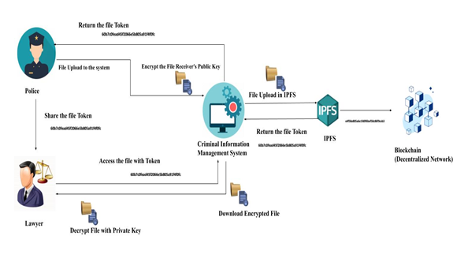
SYSTEM DIAGRAM
1.Implementing cryptography secure file management system to share file
IT20157814 | M.N H AHMED

Slide 70
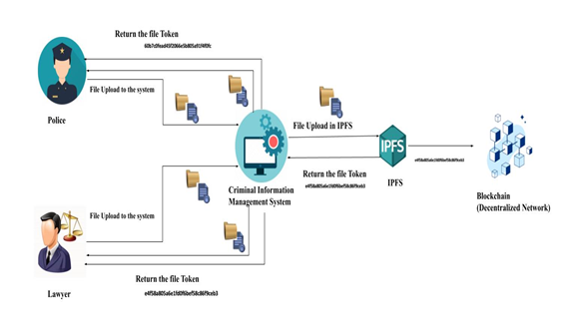
SYSTEM DIAGRAM
2. Implementing cryptography secure file management system to store file
IT20157814 | M.N H AHMED

Slide 71
REQUIREMENTS
Functional Requirements
Non-Functional Requirements
Criminal Evidence Upload
FIR, Document, Image, Video and etc.
Data Privacy and Security
Integration with Criminal System and Blockchain
Security
Performance
Reliability
Usability
Scalability
IT20157814 | M.N H AHMED

Slide 72
IMPLEMENTATION
Cryptography To Encrypt and Decrypt File
IPFS
IT20157814 | M.N H AHMED

Slide 73
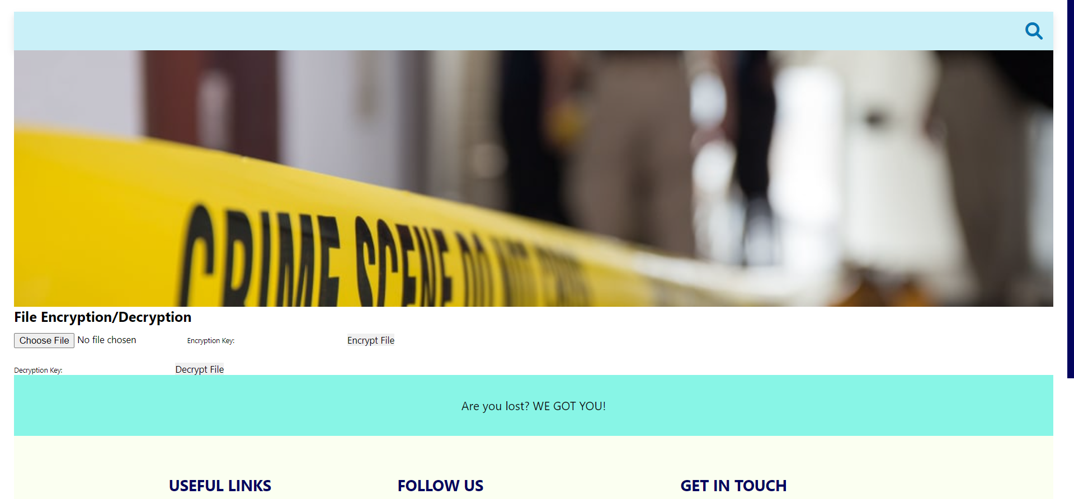
FILE ENCRYPTION AND DECRYPTION
IT20157814 | M.N H AHMED

Slide 74
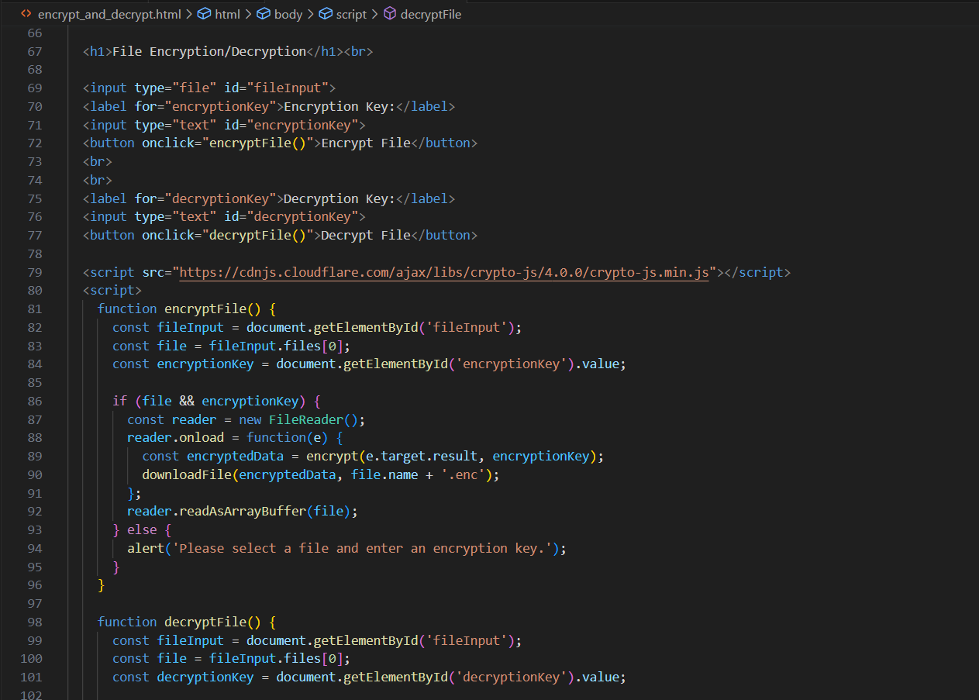
CODE
IT20157814 | M.N H AHMED

Slide 75
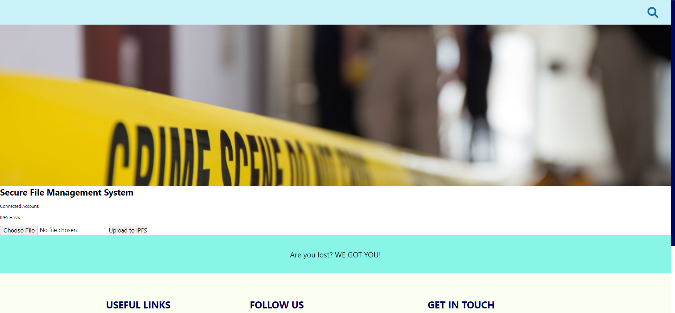
FILE UPLOAD TO IPFS
IT20157814 | M.N H AHMED

Slide 76
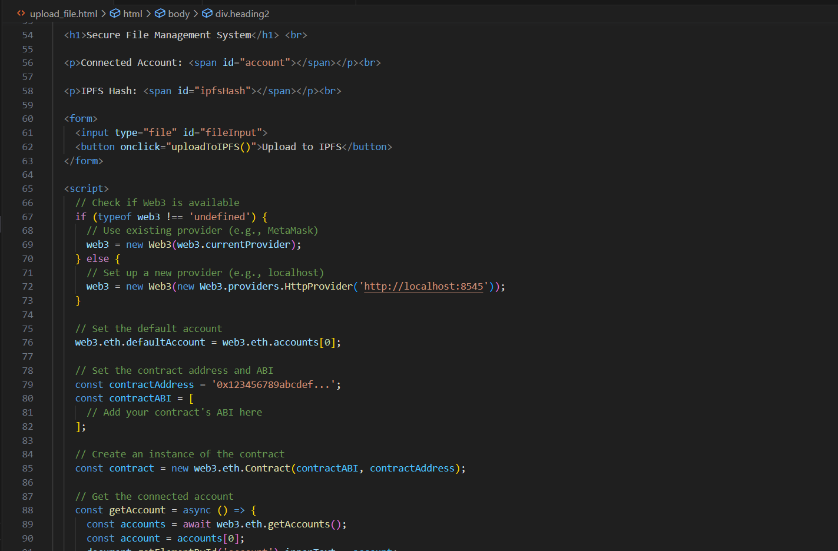
CODE
IT20157814 | M.N H AHMED

Slide 77
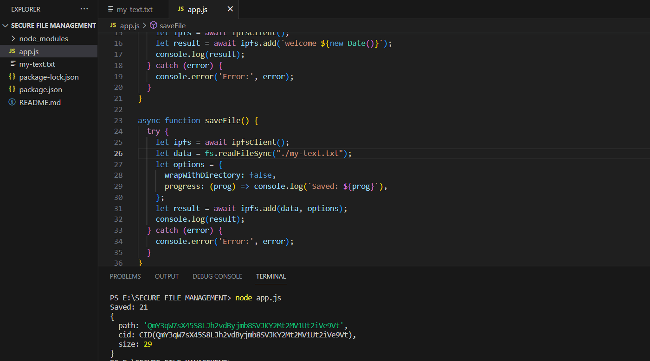
FILE UPLOAD TO IPFS AND RETRIEVE “CID” VALUE OF THE FILE
IT20157814 | M.N H AHMED

Slide 78
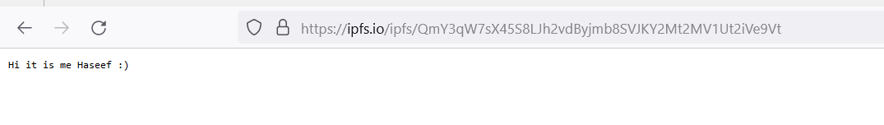
FILE UPLOAD TO IPFS
IT20157814 | M.N H AHMED

Slide 79
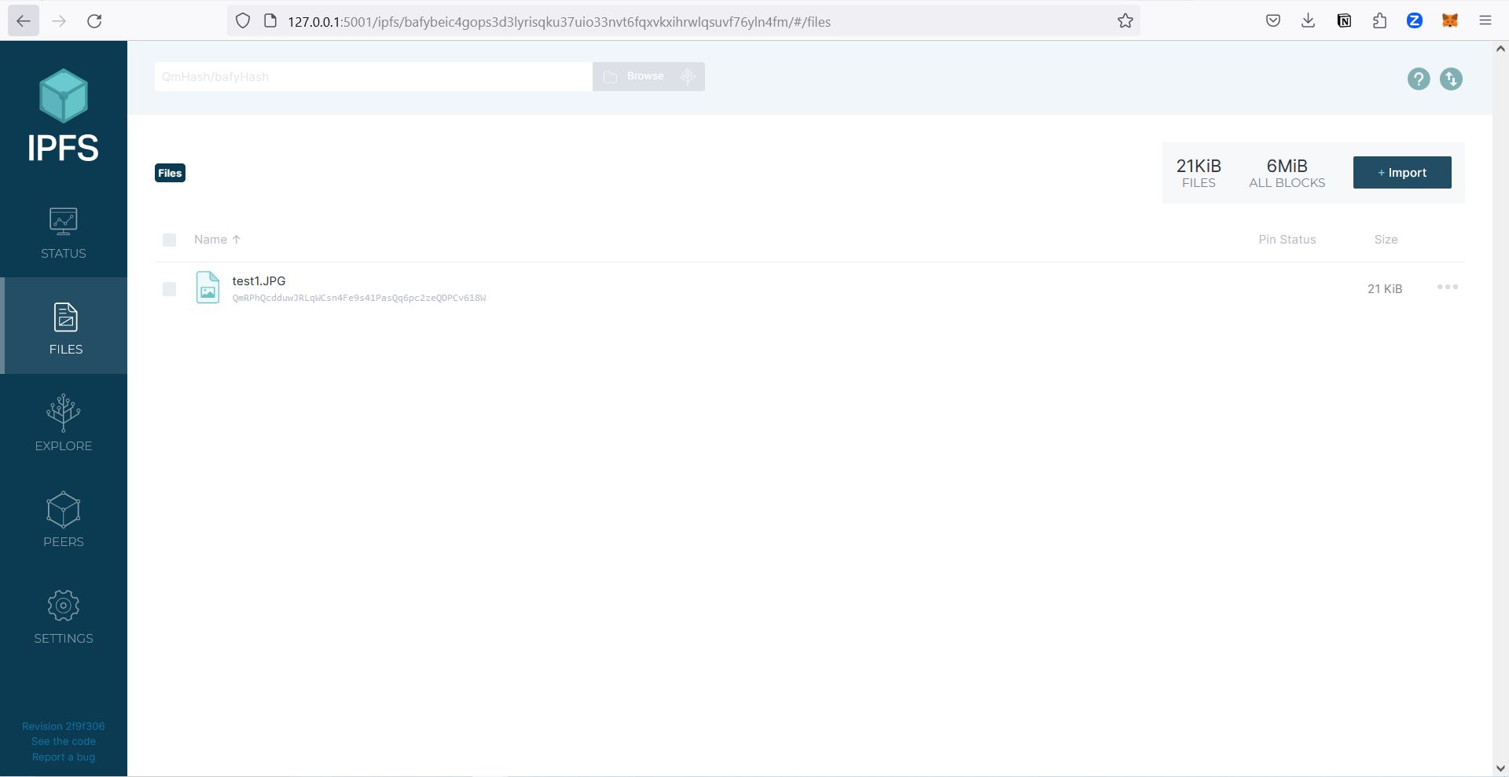
IPFS SYSTEM
IT20157814 | M.N H AHMED

Slide 80
Demonstration
IT19983370 | Thushitharan.M

Slide 81
PENDING WORK
Integrate IPFS with front end
Integrate IPFS with Blockchain
Implementing symmetric and asymmetric encryption
IT20157814 | M.N H AHMED

Slide 82
OTHER INFORMATION
GANTT CHART
SCHEDULE
REFERENCES
IT20171438 | WIJAYARATHNE S. N.

Slide 83

GANTT CHART
IT20157814 | M.N H AHMED

Slide 84
SCHEDULE
M
T
W
T
F
S
S
Week 1
-
-
-
1
2
3
4
IMPLEMENTING CRYPTOGRAPHY
Week 2
5
6
7
8
9
10
11
FINAL EXAMS
Week 3
12
13
14
15
16
17
18
INTEGRATE FRONTEND WITH IPFS
Week 4
19
20
21
22
23
24
25
TESTING & BUG FIX
INTEGRATE IPFS WITH BLOCKCHAIN
Week 5
26
27
28
29
30
1
2
INTEGRATE IPFS WITH BLOCKCHAIN
TESTING & BUG FIX
IT20157814 | M.N H AHMED

Slide 85
REFERENCES
1.E. Onuiri, A. Oludele, O. Olufunmike and S. Oluwawunmi , "A REAL-TIME CRIME RECORDS MANAGEMENT SYSTEM FOR NATIONAL SECURITY AGENCIES," May 2015. [Online]. Available: https://www.researchgate.net/publication/305426207_A_REAL-TIME_CRIME_RECORDS_MANAGEMENT_SYSTEM_FOR_NATIONAL_SECURITY_AGENCIES. [Accessed 20 March 2023].
2.A. Jain, S. Das, A. Singh Kushwah, T. Rajora and S. Saboo, "Blockchain-Based Criminal Record Database Management," 2021 Asian Conference on Innovation in Technology (ASIANCON), PUNE, India, 2021, pp. 1-5, doi: 10.1109/ASIANCON51346.2021.9544655.
3.S. Reno, S. Bhowmik and M. Ahmed, "Utilizing IPFS and Private Blockchain to Secure Forensic Information," 2021 International Conference on Automation, Control and Mechatronics for Industry 4.0 (ACMI), Rajshahi, Bangladesh, 2021, pp. 1-6, doi: 10.1109/ACMI53878.2021.9528180.
4.T.-S. C. J.-Y. W. Hsiao-Shan Huang, "A Secure File Sharing System Based on IPFS and Blockchain," 02 May 2022. [Online]. Available: https://arxiv.org/abs/2205.01728. [Accessed 20 March 2023]
5.D. Praveen, S. G. Totad, M. Rashinkar, R. Ostwal, S. Patil and P. M. Hadapad, "Scalable Blockchain Architecture using off-chain IPFS for Marks Card Validation," in 4th International Conference on Innovative Data Communication Technology and Application, 2022.
IT20157814 | M.N H AHMED

Slide 86
IT19983370 | Thushitharan .M
Specializing in Cyber Security
Chain of Custody

Slide 87
RESEARCH QUESTION
RESEARCH QUESTION
RESEARCH GAP
SUB OBJECTIVES
IT19983370 | Thushitharan.M

Slide 88

RESEARCH QUESTION
How can the implementation of chain of custody in blockchain increase the security of the criminal records management?
Chain of custody is a logical sequence of keep the records of digital evidence process.
Once peer uploads the file, the file is stored in a block including username, filesize and file data.
These block gets appended to the current blockchain, which makes it impossible to edit or delete the file/block.
The reason to implement file storing using blockchain is its ability to avoid any modification or deletion. No one can delete or corrupt our files that are stored.
IT19983370 | Thushitharan.M

Slide 89
RESEARCH GAP
CONSIDERATION ON | EXISTING LOCAL DATABASE BASED CRIMINAL INFORMATION MANAGEMENT SYSTEM IN SRI LANKA | BLOCKCHAIN TECHNOLOGY FOR CRIMINAL INFORMATION MANAGEMENT SYSTEM
Security of Sensitive Criminal Records | MEDIUM | HIGH
Decentralization Of System | No | Yes
Ensure data Integrity | LOW | HIGH
Prevent loss of data | LOW | HIGH
Log Management | Easy | Hard
Confidentiality | LOW | HIGH
IT19983370 | Thushitharan.M

Slide 90
SPECIFIC OBJECTIVES
Make the uploaded evidences immutable.
Implement Evidence log management.
Ensure Integrity, Availability.
Increase the performance and usability of criminal Records.
IT19983370 | Thushitharan.M

Slide 91
SUB OBJECTIVES
User friendly Interface
Identify the stakeholders
Recommendations and guidelines
IT19983370 | Thushitharan.M

Slide 92
SYSTEM DIAGRAM
Chain of Custody
IT19983370 | Thushitharan.M

Slide 93
FUNCTIONAL REQUIREMENTS
Immutable Evidence Records
Implement Evidence log management
Integration with Criminal System.
IT19983370 | Thushitharan.M

Slide 94
NON - FUNCTIONAL REQUIREMENTS
Security
User Friendly Interface
Performance
IT19983370 | Thushitharan.M

Slide 95
IMPLEMENTATION
IT19983370 | Thushitharan.M

Slide 96

Peer Code
IT19983370 | Thushitharan.M

Slide 97

Python code to run the application in web browser
IT19983370 | Thushitharan.M

Slide 98

Run the peer.py file
IT19983370 | Thushitharan.M

Slide 99

Run the peer.py file
IT19983370 | Thushitharan.M

Slide 100

Webview before upload the evidences
IT19983370 | Thushitharan.M

Slide 101

Web view after upload the evidences
IT19983370 | Thushitharan.M

Slide 102
Demonstration
IT19983370 | Thushitharan.M

Slide 103

PENDING WORK
IT19983370 | Thushitharan.M

Slide 104
PENDING WORK
Add evidence verification functionality through blockchain.
Add evidence log management.
Integrate the evidence details with the respective case.
Integrate with the other components
IT19983370 | Thushitharan.M

Slide 105
GANTT CHART
IT19983370 | Thushitharan.M

Slide 106
REFERENCES
Prayudi, Yudi & Sn, Azhari. (2015). Digital Chain of Custody: State of The Art. International Journal of Computer Applications. 114. 975-8887. 10.5120/19971-1856..
Anderson, G.S., Litzenberger, R. and Plecas, D. (2002), "Physical evidence of police officer stress", Policing: An International Journal, Vol. 25 No. 2, pp. 399-420.
Tasnim, Maisha & Omar, Abdullah & Rahman, Shahriar & Bhuiyan, Md. (2018). CRAB: Blockchain Based Criminal Record Management System. 294-303. 10.1007/978-3-030-05345-1_25.
IT19983370 | Thushitharan.M

Slide 107
THANK YOU!
Project Details;
Project ID: 23-270
Supervisor: Mr. Kanishka Yapa
Co-Supervisor: Ms. Dinithi Pandithage
Group Details;
IT20150952 - Brahanawardhan B
IT20171438 - Wijayarathne S. N
IT20157814 - Ahmed M. N. H
IT19983370 - Thushitharan M.
Please keep this slide for attribution.

